Slide 1
Contents
1. Percent composition of compounds
2. Empirical formula
3. Molecular formula
3. Limiting reagent
Slide <number> of 37
General Chemistry: Chapter 3
Prentice-Hall © 2002
Notes:
Chemistry 140 Fall 2002

Slide 2
Chemical Formula
Chemists use chemical formula to express the composition of molecules and ionic
compounds in terms of chemical symbol.
Three types of chemical formula:
Molecular formula
Empirical formula
Structural formula
1. Molecular formula:
Molecular formula shows the exact number of atoms of each element in the
smallest unit of a substance.
H₂ is the molecular formula of hydrogen
H₂O is the molecular formula for water
Molecular formula for acetic acid C₂H₄O₂
Slide <number> of 37
General Chemistry: Chapter 3
Prentice-Hall © 2002

Slide 3
Empirical formula
2. Empirical formula:
Empirical formula tells us which elements are present and the simplest whole-number
ratio of their atoms, but not necessarily the actual number of atoms
in a given molecule.
Consider, hydrogen peroxide.
Empirical formula of hydrogen peroxide is HO.
Molecular formula of hydrogen peroxide is H₂O₂. This formula indicates that
Each hydrogen peroxide molecule consists of two hydrogen atoms and two
oxygen atoms.
The ratio of hydrogen to oxygen atoms in this molecule is 2:2 or 1:1.
Thus, empirical formula of hydrogen peroxide is HO
Slide <number> of 37
General Chemistry: Chapter 3
Prentice-Hall © 2002

Slide 4
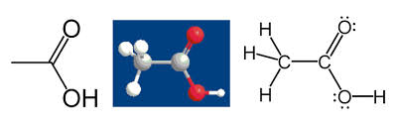
Chemical formula
3. Structural formula:
Structural formula shows the order in which atoms are bonded
together in a molecule and by what types of bond.
Structural formula of acetic acid:
Slide <number> of 37
General Chemistry: Chapter 3
Prentice-Hall © 2002

Slide 5
Percent Composition and Empirical Formula
When a new compound is made in the laboratory, its formula must be
experimentally determined
Determining the formula of a new compound begins with analyzing
the substance to find what elements it contains and how much of each
element is present- that is, to find its composition.
Percent composition of a compound is expressed by identifying the
elements present and giving the mass percent of each.
Slide <number> of 37
General Chemistry: Chapter 3
Prentice-Hall © 2002

Slide 6
The percent composition is the percent by mass of each element in a
compound
Percent composition is obtained by dividing the molar mass of each
element in 1 mole of the compound by the molar mass of the compound
and multiplying by 100 percent.
Slide <number> of 37
General Chemistry: Chapter 3
Prentice-Hall © 2002

Slide 7

Example:
In 1 mole of hydrogen peroxide (H₂O₂), there are 2 moles of H atoms and
2 moles of O atoms.
The molar masses of H₂O₂, H, and O are
34.02 g, 1.008 g, and 16.00 g, respectively.
Therefore, the percent composition of H₂O₂ is calculated as follows:
Slide <number> of 37
General Chemistry: Chapter 3
Prentice-Hall © 2002

Slide 8

Problem:
Slide <number> of 37
General Chemistry: Chapter 3
Prentice-Hall © 2002

Slide 9

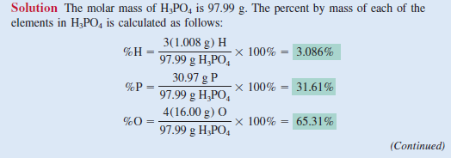
Problem:
Slide <number> of 37
General Chemistry: Chapter 3
Prentice-Hall © 2002

Slide 10
Empirical formula from percent composition
The procedure that we learnt can be reversed if necessary.
If percent composition by mass of a compound is given, we can determine
the empirical formula of the compound.
Because we are dealing with percentages and the sum of all the
percentages is 100 percent, it is convenient to assume that we started with
100 g of a compound.
Slide <number> of 37
General Chemistry: Chapter 3
Prentice-Hall © 2002

Slide 11
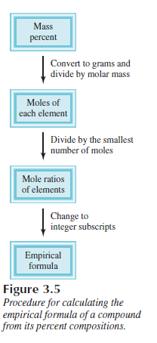
Empirical formula from percent composition
Slide <number> of 37
General Chemistry: Chapter 3
Prentice-Hall © 2002

Slide 12
Example:
A liquid sample contains 84.1% carbon and 15.9% hydrogen by mass. This means
in other words, a 100g sample of the compound contains 84.1 g of carbon atoms and
15.9 g hydrogen atoms.
Knowing a compound’s percent composition makes it possible to calculate
the compound’s empirical chemical formula.
The strategy is to find the relative number of moles of each element in the
compound and then use those numbers to establish the mole ratios of the elements.
The mole ratios, in turn, give the subscripts in the empirical chemical formula.
Slide <number> of 37
General Chemistry: Chapter 3
Prentice-Hall © 2002

Slide 13

Mass Percentages from the Formula
Suppose that A is a part of something—that is, part of a whole.
It could be an element in a compound or one substance in a mixture.
We define the mass percentage of A as the parts of A per hundred parts
of the total, by mass
Slide <number> of 37
General Chemistry: Chapter 3
Prentice-Hall © 2002

Slide 14

Example problem:
Slide <number> of 37
General Chemistry: Chapter 3
Prentice-Hall © 2002

Slide 15


Solution:
Slide <number> of 37
General Chemistry: Chapter 3
Prentice-Hall © 2002

Slide 16
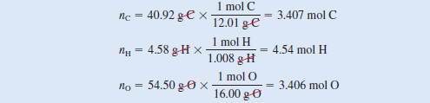

Slide <number> of 37
General Chemistry: Chapter 3
Prentice-Hall © 2002

Slide 17


Slide <number> of 37
General Chemistry: Chapter 3
Prentice-Hall © 2002

Slide 18
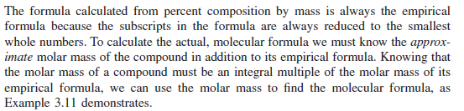

Determination of molecular formula
Slide <number> of 37
General Chemistry: Chapter 3
Prentice-Hall © 2002

Slide 19


The molecular formula of a compound is a multiple of its empirical
formula
Slide <number> of 37
General Chemistry: Chapter 3
Prentice-Hall © 2002

Slide 20
Once you determine the empirical formula for a compound, you can
calculate its empirical formula mass.
If you have an experimental determination of its molecular
mass, you can calculate n and then the molecular formula.
Slide <number> of 37
General Chemistry: Chapter 3
Prentice-Hall © 2002

Slide 21

Slide <number> of 37
General Chemistry: Chapter 3
Prentice-Hall © 2002

Slide 22


Slide <number> of 37
General Chemistry: Chapter 3
Prentice-Hall © 2002

Slide 23



Slide <number> of 37
General Chemistry: Chapter 3
Prentice-Hall © 2002

Slide 24

Slide <number> of 37
General Chemistry: Chapter 3
Prentice-Hall © 2002

Slide 25

Slide <number> of 37
General Chemistry: Chapter 3
Prentice-Hall © 2002

Slide 26

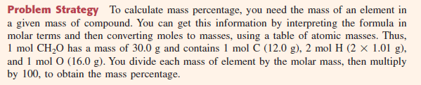
Practice problem 1
Slide <number> of 37
General Chemistry: Chapter 3
Prentice-Hall © 2002

Slide 27
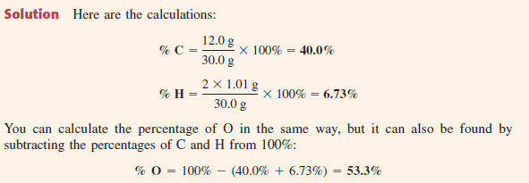
Slide <number> of 37
General Chemistry: Chapter 3
Prentice-Hall © 2002

Slide 28

Practice problem 2
Slide <number> of 37
General Chemistry: Chapter 3
Prentice-Hall © 2002

Slide 29

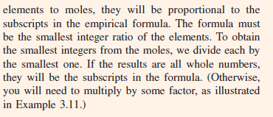
Slide <number> of 37
General Chemistry: Chapter 3
Prentice-Hall © 2002

Slide 30
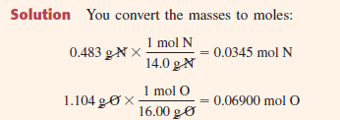
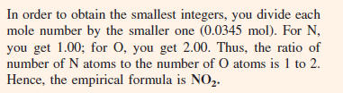
Slide <number> of 37
General Chemistry: Chapter 3
Prentice-Hall © 2002

Slide 31
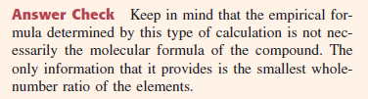
Slide <number> of 37
General Chemistry: Chapter 3
Prentice-Hall © 2002

Slide 32
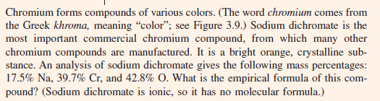
Practice problem 3
Slide <number> of 37
General Chemistry: Chapter 3
Prentice-Hall © 2002

Slide 33
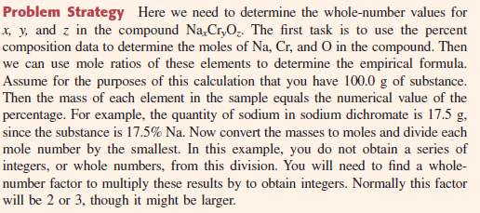
Slide <number> of 37
General Chemistry: Chapter 3
Prentice-Hall © 2002

Slide 34
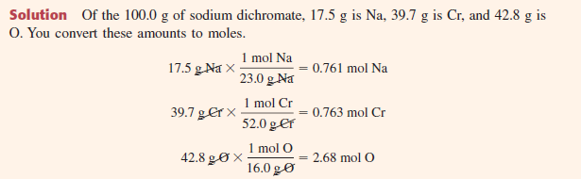
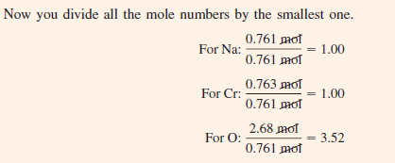
Slide <number> of 37
General Chemistry: Chapter 3
Prentice-Hall © 2002

Slide 35


Slide <number> of 37
General Chemistry: Chapter 3
Prentice-Hall © 2002

Slide 36

Practice problem 4
Slide <number> of 37
General Chemistry: Chapter 3
Prentice-Hall © 2002

Slide 37
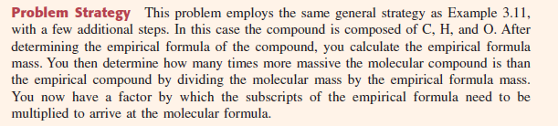
Slide <number> of 37
General Chemistry: Chapter 3
Prentice-Hall © 2002

Slide 38
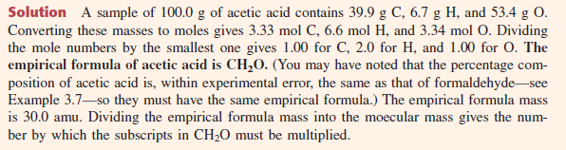

Slide <number> of 37
General Chemistry: Chapter 3
Prentice-Hall © 2002

Slide 39
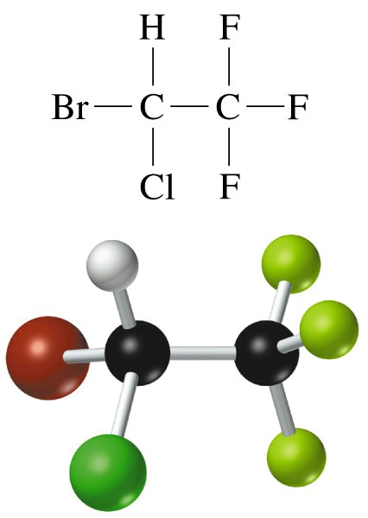
Chemical Composition
Haloethane C₂HBrClF₃
Mole ratio n_{C}/n_{halothane}
Mass ratio m_{C}/m_{halothane}
M(C₂HBrClF₃⁾ = 2M_{C} + M_{H} + M_{Br} + M_{Cl} + 3M_{F}
= (2 x 12.01) + 1.01 + 79.90 + 35.45 + (3 x 19.00)
= 197.38 g/mol
Slide <number> of 37
General Chemistry: Chapter 3
Prentice-Hall © 2002
Notes:
Chemistry 140 Fall 2002
Molecular formula tells us there are TWO moles of C per mole of halothane.
We also know about the MASSES of the compound and its elemental components.
Therefore we can talk about PERCENT COMPOSITION BY MASS

Slide 40
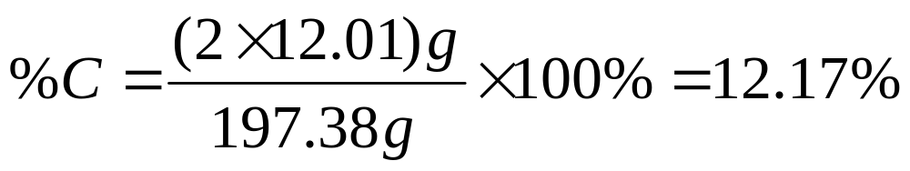
Example
Calculating the Mass Percent Composition of a Compound
Calculate the molecular mass
M(C₂HBrClF₃⁾ = 197.38 g/mol
For one mole of compound, formulate the mass ratio and convert to percent:
Slide <number> of 37
General Chemistry: Chapter 3
Prentice-Hall © 2002

Slide 41
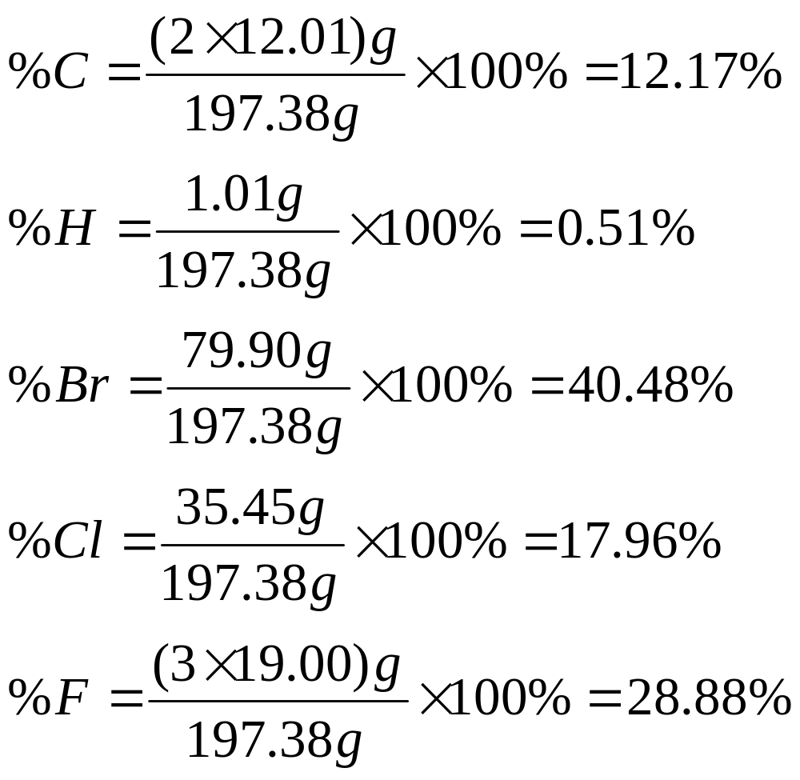
Example
Slide <number> of 37
General Chemistry: Chapter 3
Prentice-Hall © 2002
Notes:
Chemistry 140 Fall 2002
These types of calculations can be carried out in reverse for the following reasons:
Unknown compounds are analyzed for % composition.
Relative proportion of elements present on a mass basis.
Chemical formula requires mole basis, I.e. numbers of atoms.

Slide 42
Empirical formula
5 Step approach:
Choose an arbitrary sample size (100g).
Convert masses to amounts in moles.
Write a formula.
Convert formula to small whole numbers.
Multiply all subscripts by a small whole number to make the subscripts integral.
Slide <number> of 37
General Chemistry: Chapter 3
Prentice-Hall © 2002
Notes:
Chemistry 140 Fall 2002
If you know the molecular wt it is beneficial to choose that number, then only first three steps are required.

Slide 43
Example
Determining the Empirical and Molecular Formulas of a Compound from Its Mass Percent Composition.
Dibutyl succinate is an insect repellent used against household ants and roaches. Its composition is 62.58% C, 9.63% H and 27.79% O. Its experimentally determined molecular mass is 230 u. What are the empirical and molecular formulas of dibutyl succinate?
Dibutyl succinate is an insect repellent used against household ants and roaches. Its composition is 62.58% C, 9.63% H and 27.79% O. Its experimentally determined molecular mass is 230 u. What are the empirical and molecular formulas of dibutyl succinate?
Step 1: Determine the mass of each element in a 100g sample.
C 62.58 g H 9.63 g O 27.79 g
Slide <number> of 37
General Chemistry: Chapter 3
Prentice-Hall © 2002
Notes:
Chemistry 140 Fall 2002
Read the problem carefully
Pick out the critical information
Think
Follow the steps to solve the problem

Slide 44
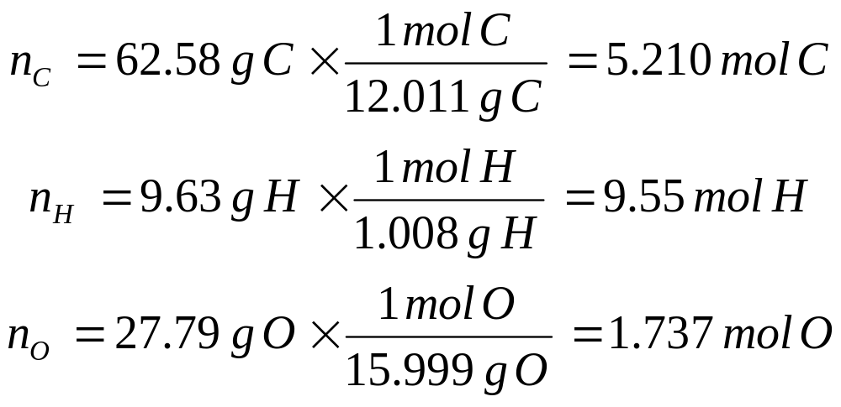
Example
Step 2: Convert masses to amounts in moles.
Step 3: Write a tentative formula.
C_{5.21}H_{9.55}O_{1.74}
Divide by smallest number (1.74)
C_{2.99}H_{5.49}O
Step 4: Convert to small whole numbers.
Slide <number> of 37
General Chemistry: Chapter 3
Prentice-Hall © 2002

Slide 45
Example
Step 5: Convert to a small whole number ratio.
Multiply by 2 to get C_{5.98}H_{10.98}O₂
The empirical formula is C₆H₁₁O₂
Step 6: Determine the molecular formula.
Empirical formula mass of C₆H₁₁O₂ is 115 u.
Experimentally determined molecular formula mass is 230 u.
The molecular formula is C₁₂H₂₂O₄
Slide <number> of 37
General Chemistry: Chapter 3
Prentice-Hall © 2002
Notes:
Chemistry 140 Fall 2002
Step 5. You can multiply the rounded off one if you wish, but be careful of introducing an error
If all the subscripts are within ±0.1 you are probably OK to round to the integer.
Step 6: Simple multiplication is obvious here.

